Slide 1
1 v 1 to cones
Equipment needed
1 ball between 2
2 cones about 10 steps apart
How to play
Always start stood next to the cone which you are defending
Try to stop the ball on the other players cone
Defend your cone!
Take it in turns to start
First to 5 goals then find someone else to play against

Slide 2
Kick up challenges
Equipment needed
1 ball
Challenges
How many kick ups can you do with 1 bounce in between?
How many times can you keep the ball up with your knees / thighs?
How many kick ups can you do without a bounce?
How many kick ups can you do using Left Foot then Right Foot?
How far can you get going – 1 left foot, 1 right foot (stop)… then 2 left foot 2 right foot (stop)…. 3 left foot, 3 right …. If you drop the ball start again
Ultimate challenge – Pele 7
Left foot , right foot, left knee, right knee, left shoulder, right shoulder, head

Slide 3
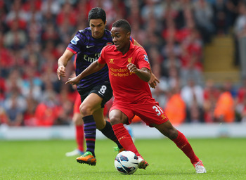
Make your own Game
Equipment needed
4 cones 1 ball
Challenges
What game can you and your partner come up with using 1 ball and 4 cones set out in a square?

Slide 4
Kick ups in pairs
Equipment needed
2 players 1 ball
Challenges
How many times can you pass the ball between you with one bounce ?
How many times can you head the ball to each other without it touching the ground?
How many times can you pass it to each other without the ball touching the floor?
How many times can you pass it to each other without the ball touching the ground ? you must take 2 touches
How many times can you pass the ball to each other, without it touching the ground, must take 2 touches, using 2 different surfaces (i.e. Left foot laces, right foot inside)

Slide 5
Shadow defending
Equipment needed
2 players
1 ball
2 cones
Set up
2 cones 10 steps apart
Activity
1 player dribbles to beat the other player practicing using tricks and skills
Defender can’t tackle pretend
Take it in turns to practice

Slide 6
Race to the cone
Equipment needed
2 players
1 ball
2 cones
Set up
2 cones 10 steps apart
Players face each other half way
Activity
Pick a leader, leader tries to get to a cone before the other person, can trick and dodge.
If leader gets there first they get a point, if follower does they get a point
Take it in turn to be the leader
Add a ball…. Leader must touch the ball on the cone, follower can’t touch the ball

Slide 7
Hit the spot
Equipment needed
2 players
1 ball
1 cone or spot
Set up
Put the cone or spot down, both players take 10 steps back from the marker.
Activity
Players take it in turns to try to hit the mark either to roll over it, or to bounce the ball on it
Balance a ball on the cone, try to hit the ball without it bouncing.

Slide 8
Through the gate
Equipment needed
2 players
1 ball
2 cones
Set up
Put the two cones side by side, about a step apart – both players take 10 steps back
Activity
Take it in turns to try and pass through the gate
Get a point for each time you make it through the gate
Try changing the size of the gate or moving further back to make it harder or easier

Slide 9
2 v 2 to end lines
Equipment needed
4 players
1 ball
4 cones
Set up
Put the cones in a rectangle 15 steps apart length, 10 steps wide
Activity
Both teams start on their end line, score by stopping the ball on the oppositions end line.
Change it – when you score, you keep the ball, turn around and try to score at the other end

Slide 10
Mini game
Equipment needed
1 ball
4 cones
Set up
Set out goals, one step wide
Activity
Play a game, no more than 4 v 4.

Slide 11
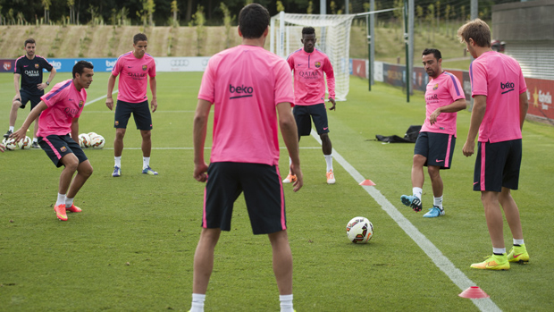
Rondo
Equipment needed
1 ball
Set up
Stand in a small circle, one person in the middle
Activity
Players try to keep ball away from person in the middle by passing it to each other, defender tries to win it. Whoever makes the mistake on the outside that loses the ball goes into the middle.
Variations
Have two people in the middle, the person who makes the mistake and the player to their left goes in the middle
Challenges
Make it 1 touch only or must take two touches or one touch with each foot

